Slide 1
Price Monitoring – one step beyond
Amat victoria curam (Victory loves preparation)

Slide 2
The Inspiration
takolako.rs – our own use case
Why monitor market prices?
2010 Q3 – internal usage
Financial crisis makes buyers think twice
0.50 USD difference in price can make a huge impact on the turnover
In 6 months our turnover went up by 32%
Product managers can do their real job
2010 Q1 – lets do it manually
2011 Q1 – Price2Spy is born!
Manual product monitoring – Excel sheets
Takes real lot of valuable time, no analytics
Humans make mistakes, humans forget about things
We can do better than that!
This tool is working well!
Lets offer it to the world!

Slide 3
Price2Spy – 5 years on
Nearly 300 clients
Experience makes the difference
Practically all industries
All markets / all continents
Retailers
Distributors
Manufacturers
In such a young industry, 5 years in business makes the difference
Fast and no-nonsense support
Flexible in size
We listen to our clients
From small family businesses, 50-100 products
Up to large multinationals, monitoring 0.5M products across different markets / countries
80% of features came as a result of our clients’ ideas!
New features every month or so
Any new ideas? We’d love to hear from you!

Slide 4
Reactive or Proactive price monitoring?
Reactive
Monitor competitor prices, as frequently as possible
React to price change alerts, adjust your own prices accordingly (possibly via API)
Identify pricing opportunities: smart raise / smart drop
Suitable for small players, not established on the market
4

Slide 5
Reactive or Proactive price monitoring?
Proactive
Monitor competitor prices, use analytical tools
Understand what causes market changes
Understand competitor / retailer behavior
Be the one who drives the change!
Suitable for market leaders
5

Slide 6
Pricing leaders vs Pricing followers
Distinguishing leaders / followers
How to recognize who’s monitoing & following whom
All brands / categories, or just some of them?
Why did they drop their prices?
Promotion? Better supplier deal? Getting rid of stock?

Slide 7
Pricing leaders vs Pricing followers
Price change dynamics
How often do they change their prices?
How often do they run out of stock?
How often do they run promotions?
Automated or manual price change process?
Currencies: FX rate impact

Slide 8
Price Monitoring - feature guide
Essential
Advanced (and not so obvious)
Accuracy (ability to detect exceptional cases)
Capturing more than price (shipping cost, delivery time, seller name etc…)
Scalability (hundreds or millions of SKUs – should not matter)
B2B sites (requiring client login)
Price in cart (sites which show different prices after products gets placed in the cart)
Alerting (if you go for Reactive model)
Analytics (if you go for Proactive model)
Monitoring MAP violations (who’s playing fair, who’s not)

Slide 9
Price Monitoring - feature guide
Yet more advanced (and yet less obvious)
Price check frequency (in some cases daily price checks are not enough)
API integration (get pricing data directly into your own software)
Distributed / stealth price checks (not everyone wants to be monitored)
Discretion, discretion, discretion (they might know that we’re monitoring their prices, but they will never know on whose behalf)

Slide 10
Why Price2Spy?
No software to install, no servers to maintain
No site is too difficult to monitor
.
.
You choose the course and the strategy
Tight integration with your ERP
Leave the rest to the
team of Price2Spy's professionals

Slide 11
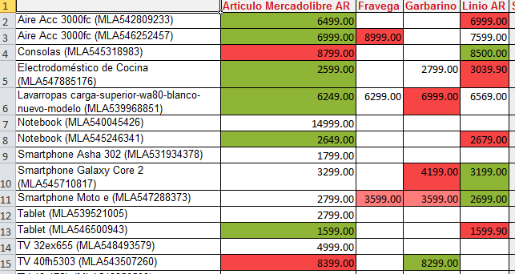
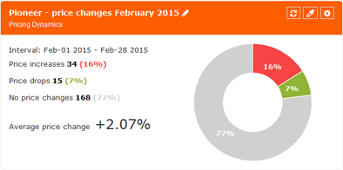
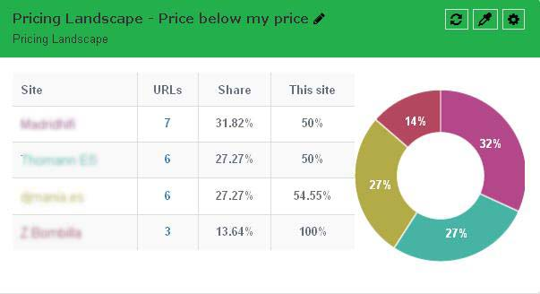
Reports / Charts

Slide 12
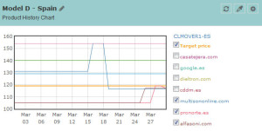
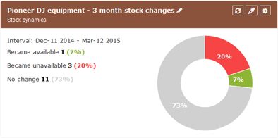
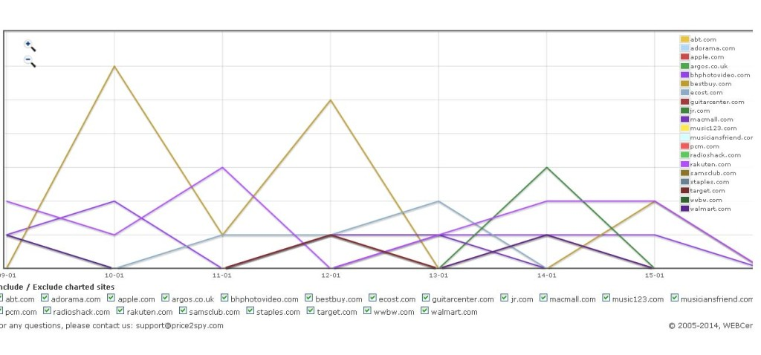
Reports / Charts

Slide 13
Price Monitoring – one step beyond
Amat victoria curam (Victory loves preparation)

